Slide 1


Steven Xu
3/3/2022

Slide 2

Outline
Executive Summary
Introduction
Methodology
Results
Conclusion
Appendix

Slide 3
Executive Summary
Summary of methodologies
Data Collection API
Data Wrangling
Exploratory Data Analysis (EDA) with SQL
EDA with Data Visualization
Data Visualization with Folium
Building a dashboard with Plotly Dash
Machine Learning Prediction
Summary of all results
EDA results
Interactive analytics in screenshots
Predictive analytics results

Slide 4
Introduction
Project background and context
In this project, we will predict if the Falcon 9 first stage will land successfully. SpaceX advertises Falcon 9 rocket launches on its website, with a cost of 62 million dollars; other providers cost upward of 165 million dollars each, much of the savings is because SpaceX can reuse the first stage. Therefore if we can determine if the first stage will land, we can determine the cost of a launch. This information can be used if an alternate company wants to bid against SpaceX for a rocket launch.
Problems you want to find answers
What factors influence the success rate of landings?
What is the size of the effect of each relevant variable in determining success rates?
What conditions does SpaceX need to get the best results and the highest landing success rates.

Slide 5

Section 1

Slide 6
Methodology
Executive Summary
Data collection methodology:
The data for this project was collected via webscraping from wikipedia and the SpaceX API.
Perform data wrangling
One-hot encoding was used to transform categorical variables (such as whether a launch was successful), and irrelevant columns of data were dropped.
Perform exploratory data analysis (EDA) using visualization and SQL
Perform interactive visual analytics using Folium and Plotly Dash
Perform predictive analysis using classification models
How to build, tune, evaluate classification models

Slide 7
Data Collection
SpaceX launch data was gathered from the SpaceX REST API
From this API, we can retrieve data on launches, such as launch site, payload size, landing outcome, and more.
In addition, data was collected via webscraping Wikipedia with BeautifulSoup.
SpaceX API
Use SpaceX Rest API
API returns data in JSON format
Read data into csv format

Slide 8
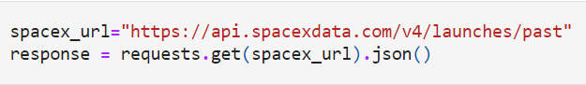
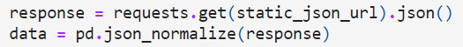
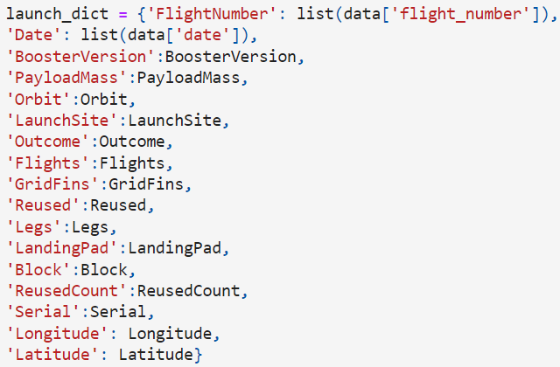
Data Collection – SpaceX API
GitHub URL to Notebook
1. Get Response from API
2. Convert response to json
3. Clean the data
4. Assign to dictionary, then dataframe
5. Filter dataframe for Falcon 9 and export to csv

Slide 9
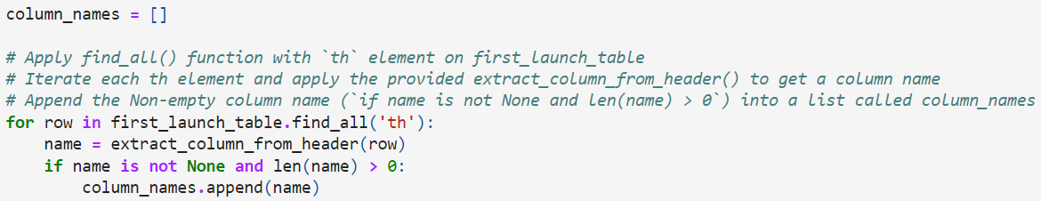
Data Collection - Scraping
1. Get request and create BeautifulSoup object
2. Find tables and column names
3. Create dictionary and add data to keys
(refer to cells 12 and 14)
4. Create dataframe from dictionary and export to csv
GitHub Link

Slide 10

Data Wrangling
We calculated the number of launches on each site and the frequency of each orbit type.
We then sorted landings into success/failure based on the type and added this data to the dataframe before saving this data to a csv file.
GitHub Link

Slide 11
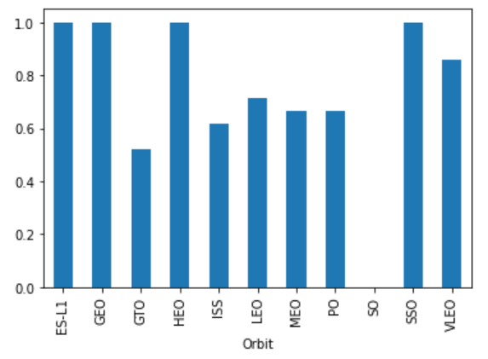
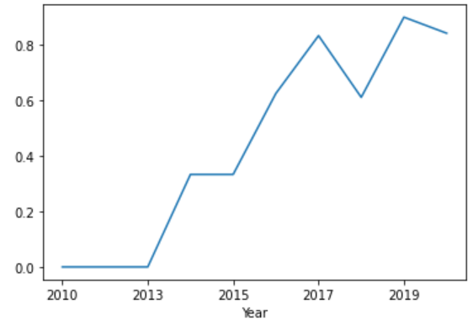
EDA with Data Visualization
Scatterplots drawn:
Payload mass vs flight number
Flight number vs launch site
Payload mass vs launch site
Flight number vs orbit type
Payload mass vs orbit type
Line graph: Success Rate vs Year
Bar graph: Mean vs Orbit
Github link

Slide 12
EDA with SQL
The SpaceX dataset was loaded into a DB2 SQL database, several of the queries were to:
Display the unique launch sites
Display 5 records with launch sites starting with 'CCA'
Display total payload mass of all boosters launched by NASA (CRS)
Display average payload mass carried by booster version F9 v1.1
List the date of the first successful landing outcome in ground pad
List the names of boosters with success in drone ship and payload mass between 4000-6000
List the total number of successful and failure mission outcomes
List the booster versions that have carried the maximum payload mass
List the failed landing outcomes in drone ship, their booster versions, and launch sites in 2015
Rank the count of landing outcomes between June 4, 2010 and March 20, 2017
Github link

Slide 13
Build an Interactive Map with Folium
A marker was added to each of the SpaceX launch sites and the NASA Johnson Space Center, as well as a label with their names.
Next, the launch outcomes from each of the launch sites was displayed with red circles indicating failed launches and green circles indicating successful ones.
From here, we calculated the distance from a launch site to various nearby landmarks, such as railways, highways, coastline, and cities, to see if there were trends in the distances to these points.
Launch sites tend to be close to the coast and away from cities, railways, and highways.
github link

Slide 14
Build a Dashboard with Plotly Dash
A pie chart displays the total launches, toggleable by a specific site or all sites, to show the relative proportions of launches by site.
A scatterplot shows the correlation between payload mass and launch success, with each booster version color coded. This type of plot was chosen because it clearly displays the distribution of payload sizes for each outcome.
github link

Slide 15
Predictive Analysis (Classification)
Loaded the data with numpy and pandas, transformed and split the data into training and test sets
Built several different machine learning models and tuned hyperparameters with GridSearchCV, and plot confusion matrix
Check accuracy for each model, improving it with feature engineering and algorithm tuning
The model with the highest accuracy score is the best performing model
github link

Slide 16
Results
Exploratory data analysis results
Interactive analytics demo in screenshots
Predictive analysis results

Slide 17

Section 2

Slide 18
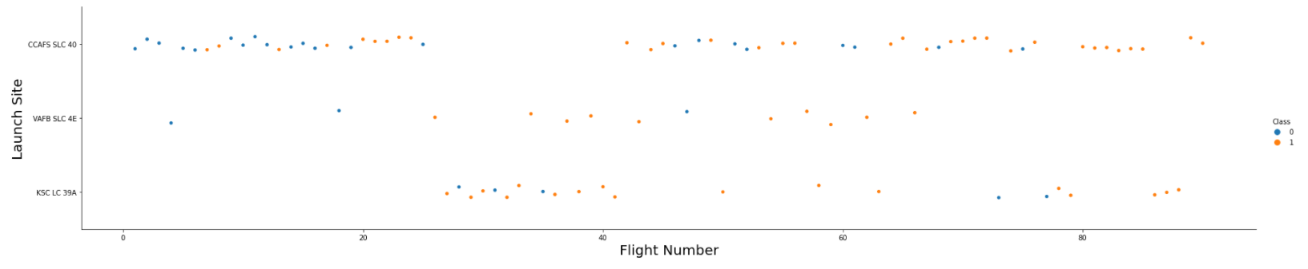
Flight Number vs. Launch Site
Launches tend to be more successful over time, which makes sense intuitively because later launches will have had more prior experience as well as likely better technology.

Slide 19
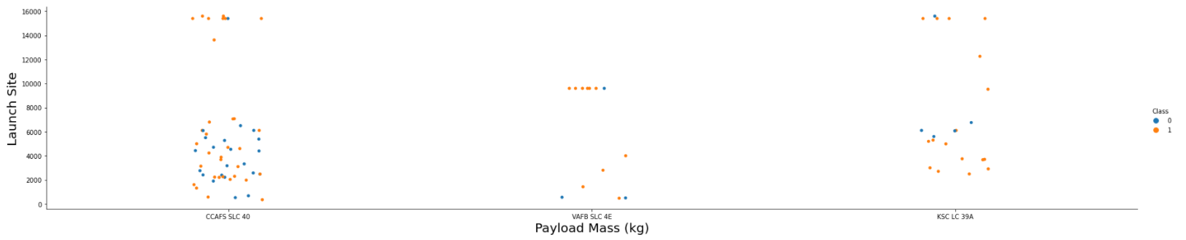
Payload vs. Launch Site
CCAFS SLC 40 shows higher success rates with larger payloads, but there is not a clear pattern given that the other two sites do not have this trend.

Slide 20
Success Rate vs. Orbit Type
ES-L1, GEO, HEO, SSO have the highest success rate out of the orbit types.

Slide 21
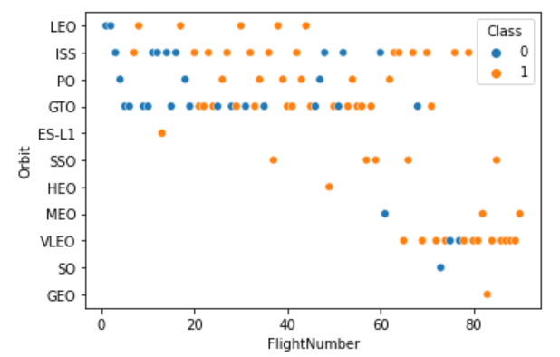
Flight Number vs. Orbit Type
In LEO there is a strong correlation between flight number and success, but the relationship in the other orbit types is less clear.

Slide 22
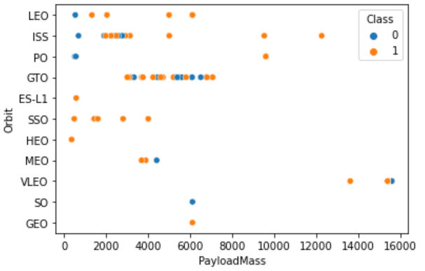
Payload vs. Orbit Type
Payload size seems to have a positive effect on the success of LEO and ISS orbits, but is inconclusive for GTO.

Slide 23
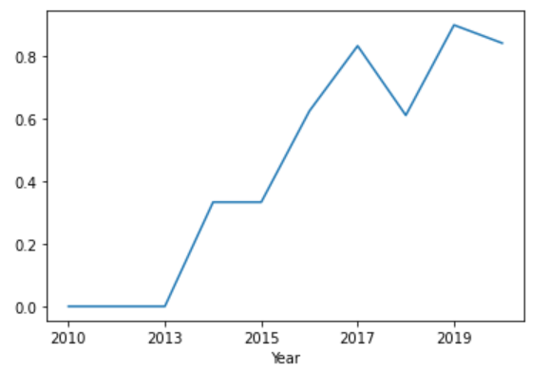
Launch Success Yearly Trend
There is a general upward trend in success rate of launches over time starting from 2013.

Slide 24
EDA WITH SQL

Slide 25
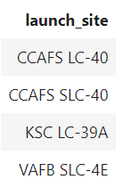
All Launch Site Names
Using the distinct keyword filters out duplicate entries from appearing.

Slide 26
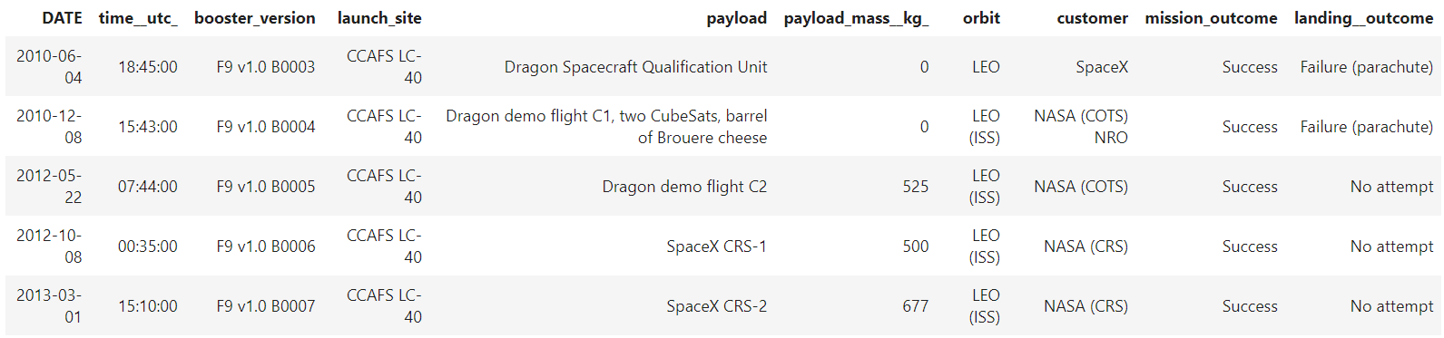
Launch Site Names Begin with 'CCA'
LIMIT 5 limits the results to the first 5 entries that satisfy the condition of starting with CCA, which is found using CCA%, % serving as a wild card.

Slide 27
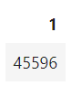
Total Payload Mass
SUM sums up the total in the payload mass column with the WHERE clause filtering to only NASA (CRS) entries.

Slide 28
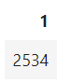
Average Payload Mass by F9 v1.1
AVG finds the average of the payload mass column, while the WHERE clause is to filter the dataset to only entries with booster version F9 v1.1.

Slide 29
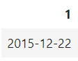
First Successful Ground Landing Date
MIN(DATE) finds the lowest (i.e. first) date from a given set, and the where clause is used to limit the search to successful ground pad landings.

Slide 30
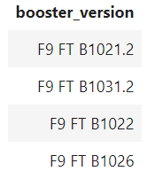
Successful Drone Ship Landing with Payload between 4000 and 6000
UNIQUE removes duplicate booster versions from appearing, WHERE filters the dataset to only entries with a successful drone ship landing, AND specifies an additional clause to filter down to entries with payload mass between 4000-6000 kg.

Slide 31
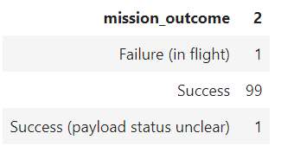
Total Number of Successful and Failure Mission Outcomes
GROUP BY groups the output by mission outcome, and COUNT counts the number of times a mission outcome appears.

Slide 32
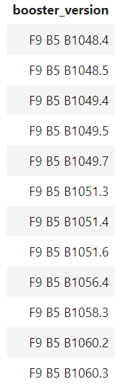
Boosters Carried Maximum Payload
UNIQUE prevents duplicate entries from appearing, and the subquery allows us to fetch the max payload size so that can be used as a filter.

Slide 33
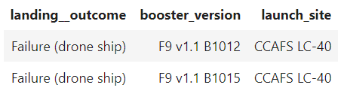
2015 Launch Records
Year(date) for finding only 2015 entries and landing_outcome='failure (drone ship)' for finding specifically failed landing outcomes by drone shop and nothing else.

Slide 34
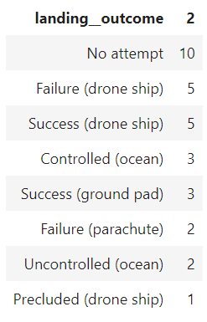
Rank Landing Outcomes Between 2010-06-04 and 2017-03-20
Between searches for dates between the two dates listed, order by sorts by number of landing outcomes, and desc sorts in descending order.

Slide 35

Section 3

Slide 36
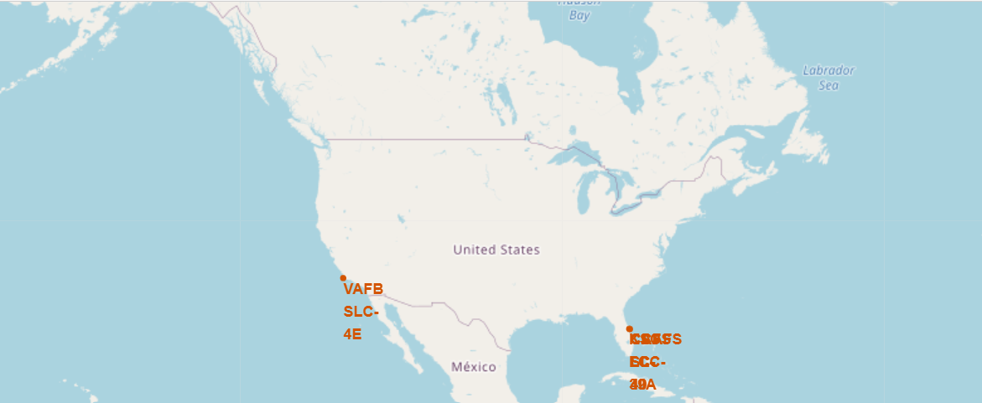
SpaceX Launch Sites
The SpaceX launch sites are in California and Florida.

Slide 37
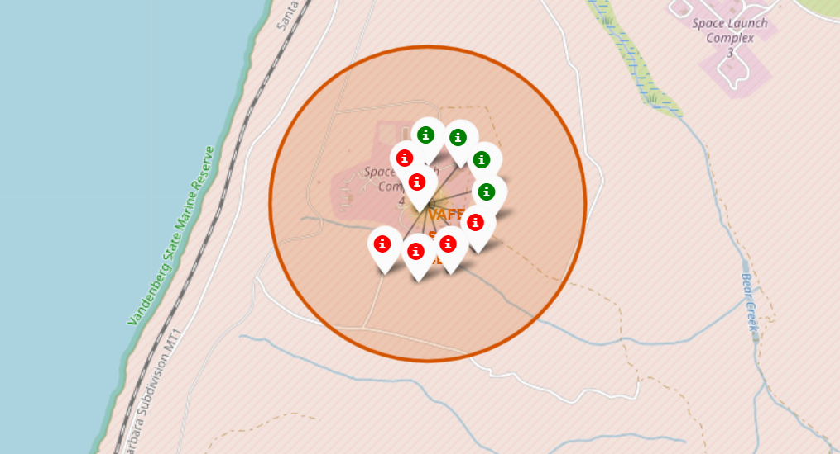
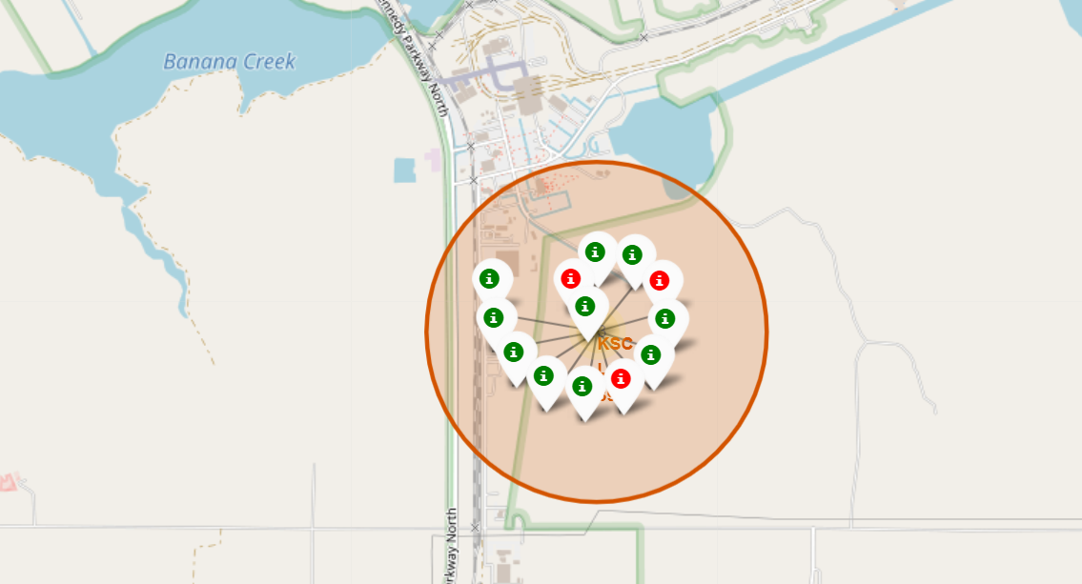
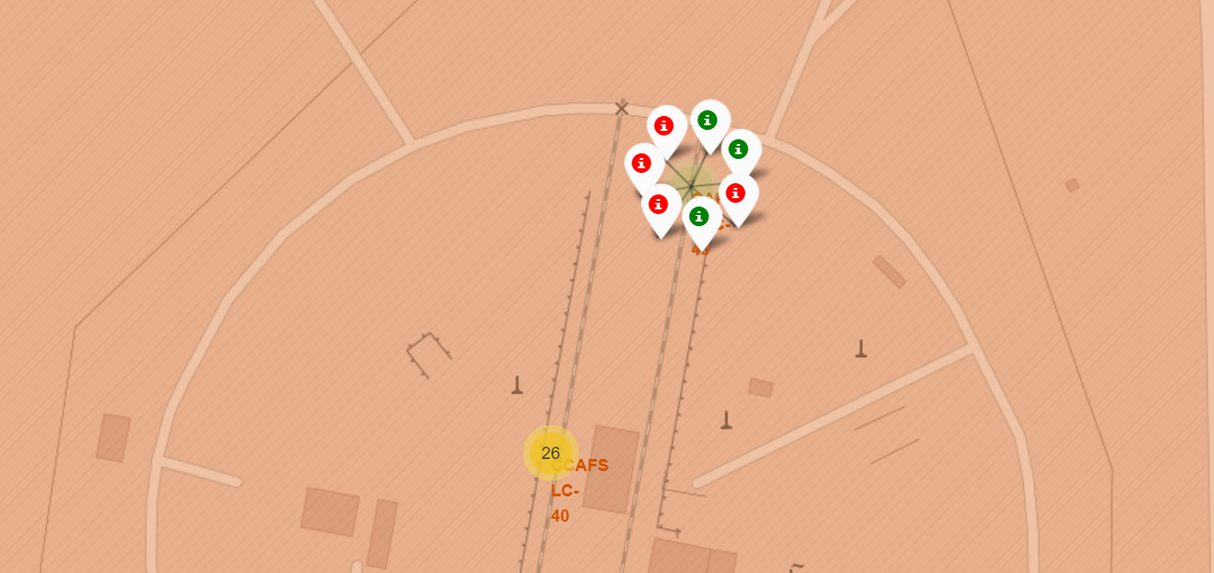
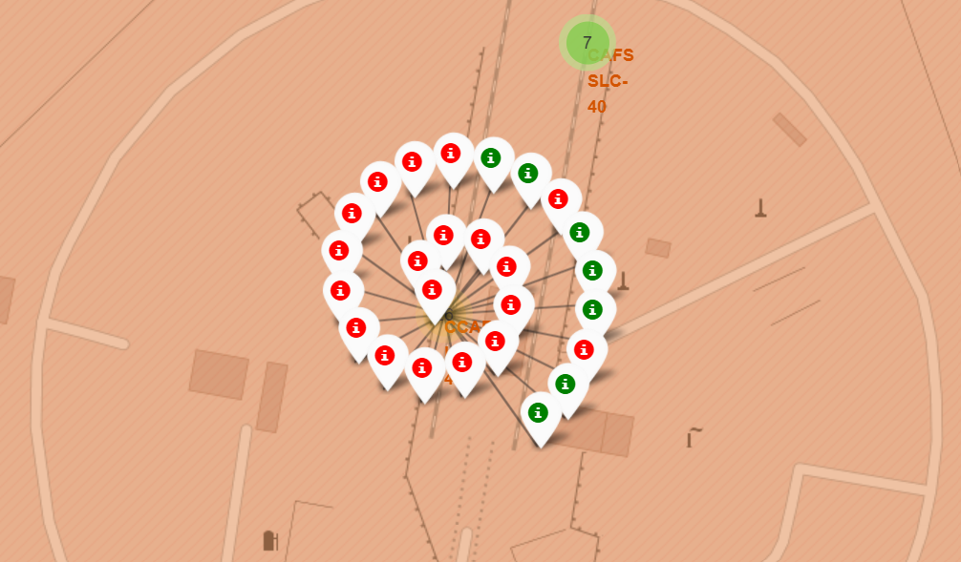
Launch Markers
Green is a successful launch and red is a failed launch.

Slide 38
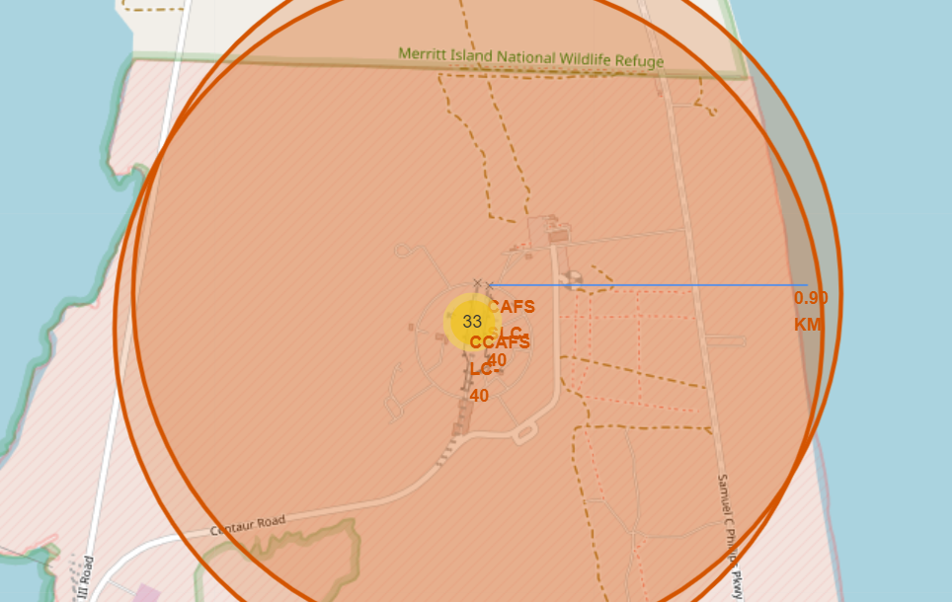
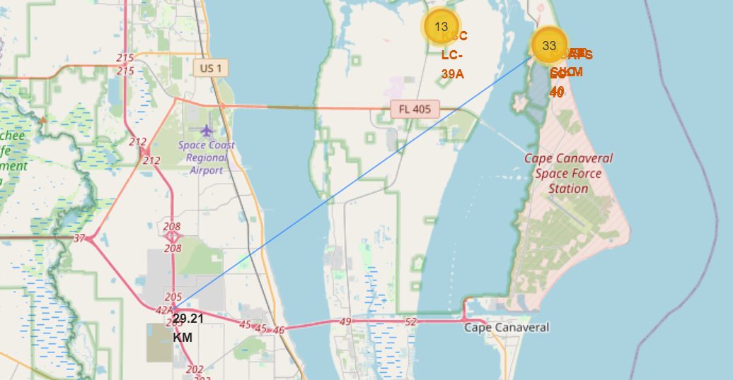
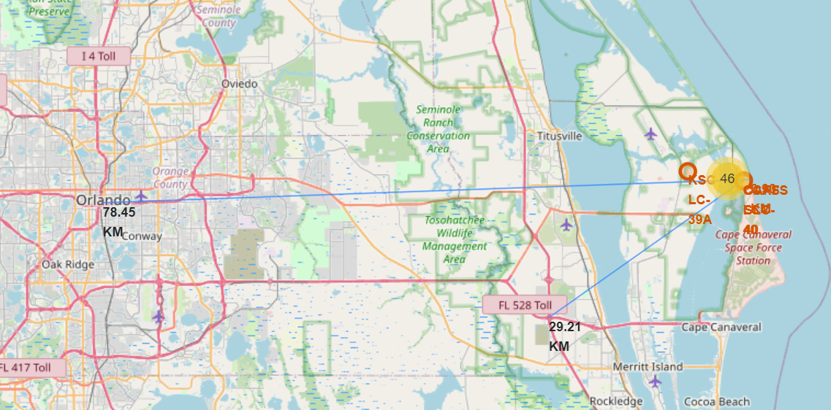
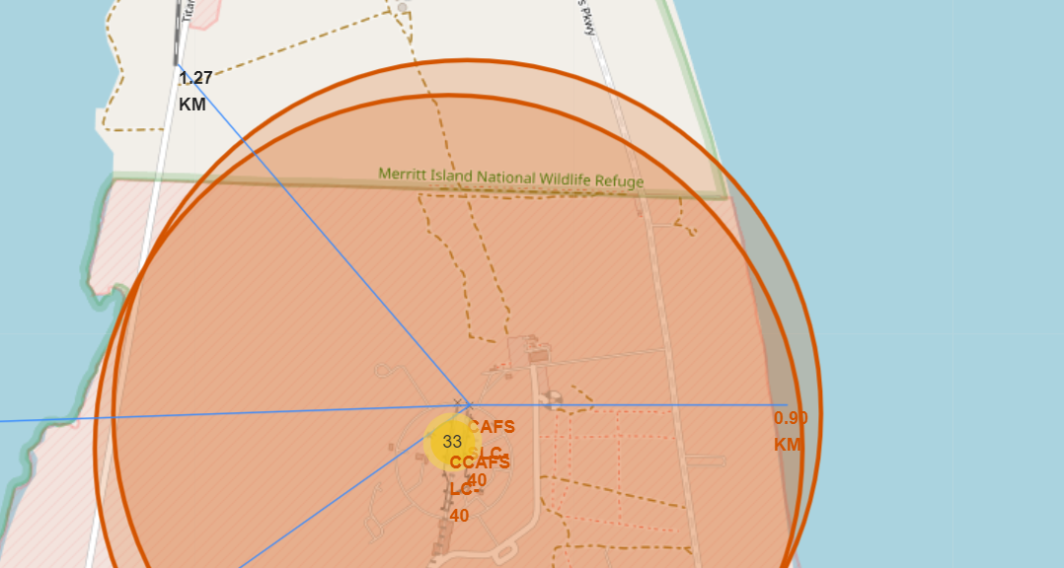
Launch Site Distances to Various Landmarks
Launch sites are near railways and the coast, and away from cities and highways.

Slide 39

Section 4

Slide 40
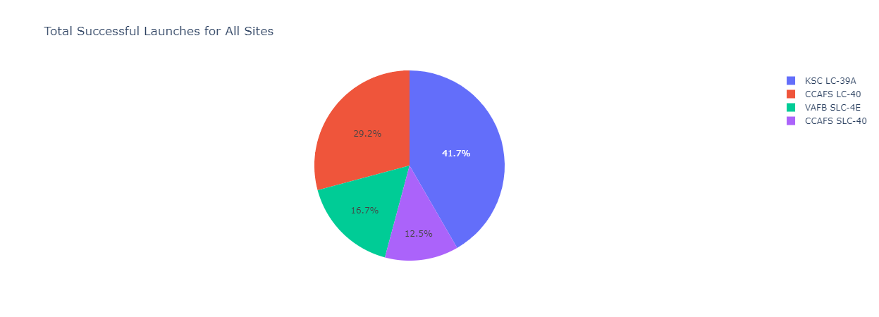
Dashboard-Success Rate of Each Launch Site
From this pie chart we can see that KSC LC-39A has the most successful launches and CCAFS SLC-40 has the least.

Slide 41
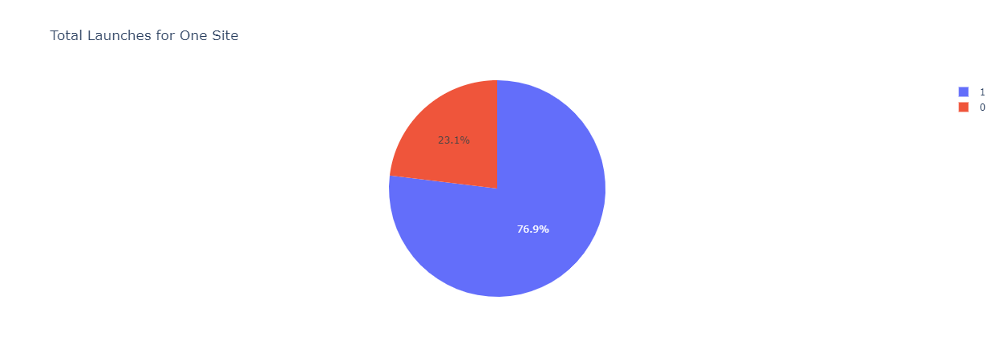
Pie Chart for Launch Site with Most Successes
76.9% of launches here were successful while 23.1% failed.

Slide 42
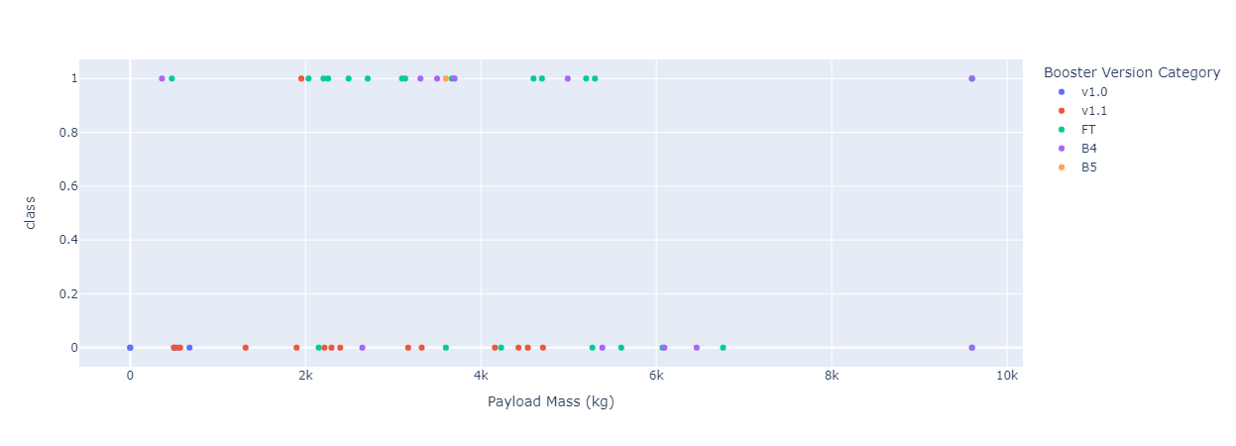
Payload vs Launch Outcome
For heavier payloads (>6k kg), the success rate of launches drops off compared to lighter payloads.

Slide 43

Section 5

Slide 44
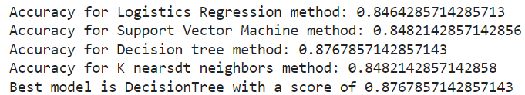
Classification Accuracy
The decision tree narrowly wins out over the other 3 methods as the most accurate.

Slide 45
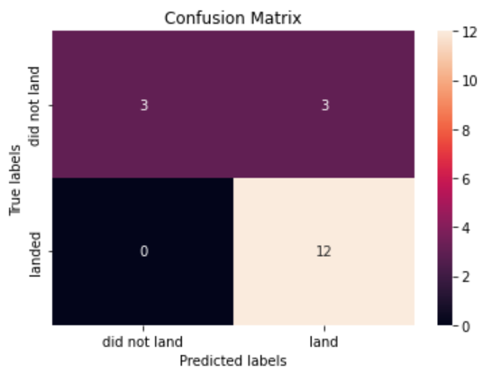
Confusion Matrix
The decision tree (and every other model) can correctly identify launches with successful landings, but struggles to correctly identify unsuccessful landings.

Slide 46
Conclusions
The decision tree model does slightly better than the other 3 models.
Lighter payloads have higher success rates than heavier ones.
Success rate improves over time, which makes sense as everyone involved becomes more experienced.
The KSC LC-39 A site has the most successful launches of the 4.

